Slide 1



Predicting Housing Prices
ST1511
Goh Kun Ming
P2415691
DAAA/FT/1B/02

Slide 2

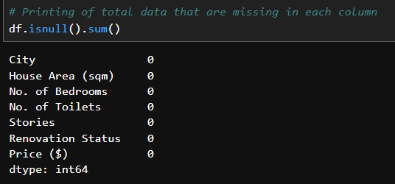
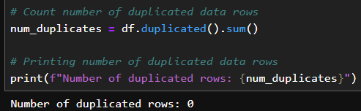
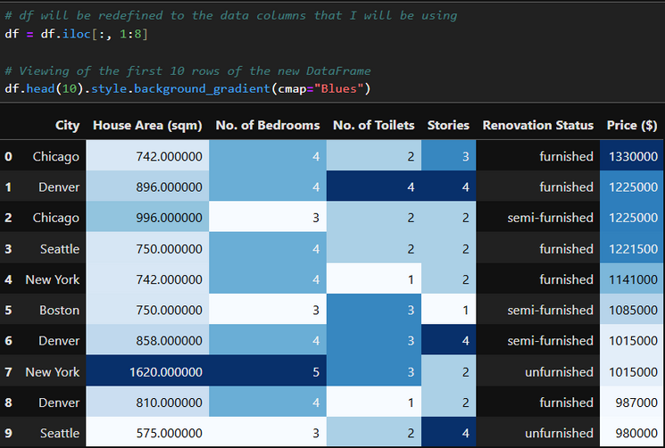
Data Cleaning & Analysis
No Missing Data
No Duplicated Data
Dropping Exclusive Data

Slide 3
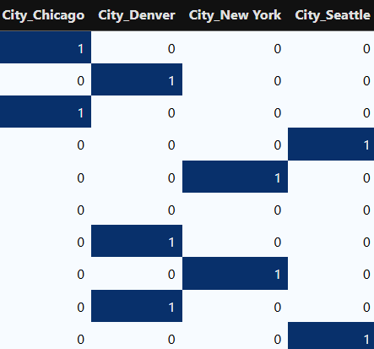
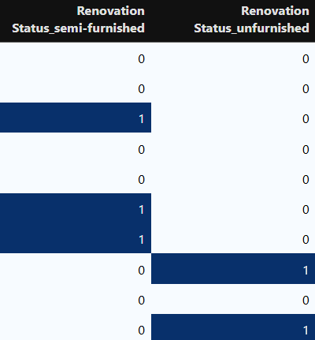
Feature Engineering (Dummy Variables)
Dummy Variable for Cities
Dummy Variable for Renovation Status

Slide 4
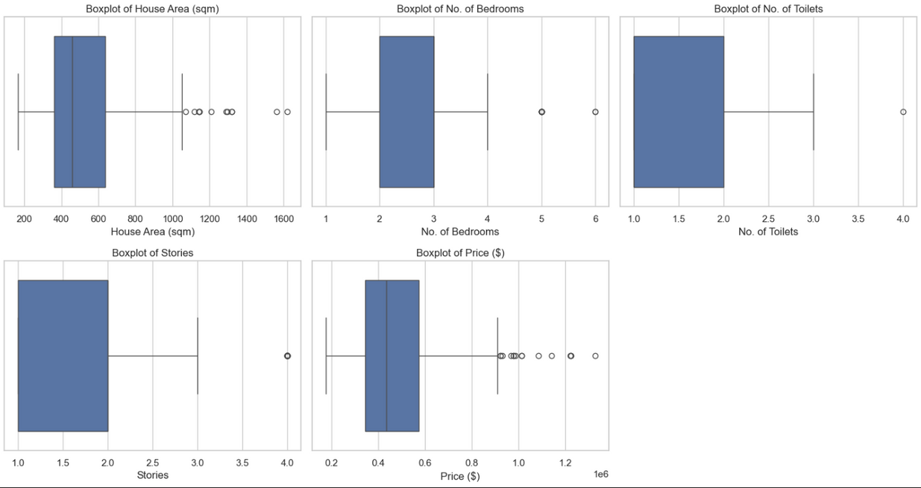
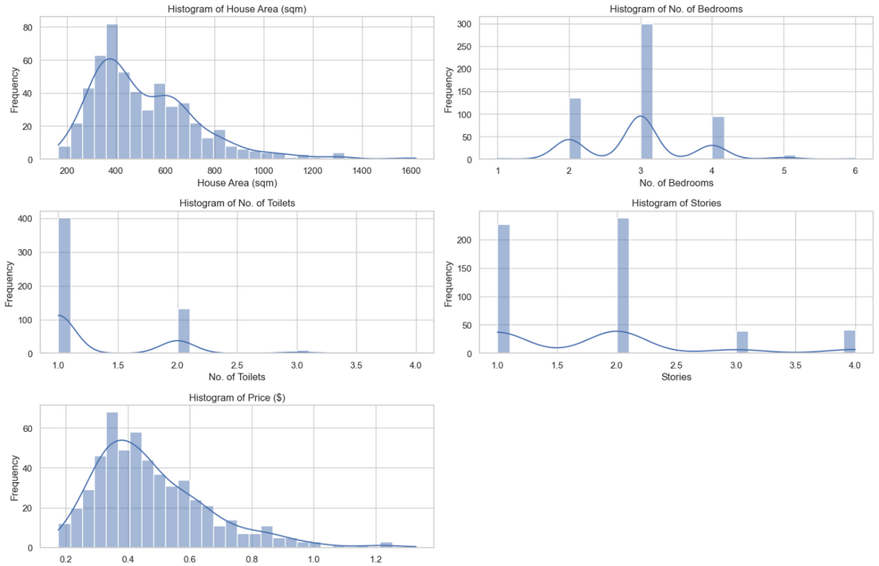
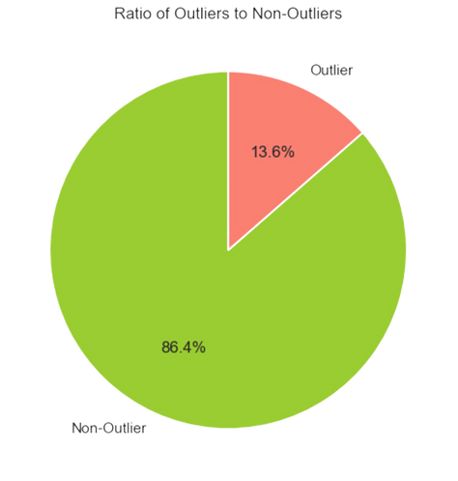
Feature Engineering (Outliers Identification)
Box Plot
Histograms
Outliers Ratio:
Not Removing Outliers due to Limited Data.

Slide 5
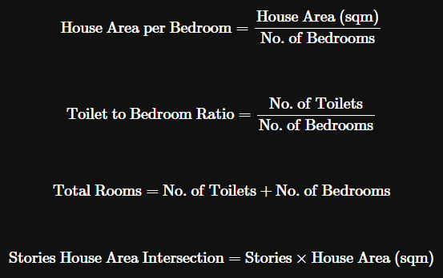
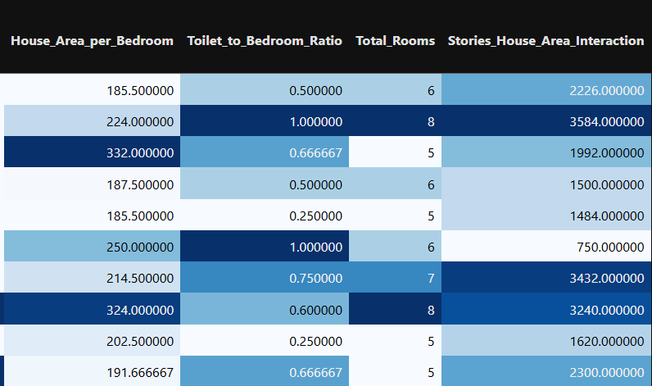
Feature Engineering (Feature Creation)

Slide 6
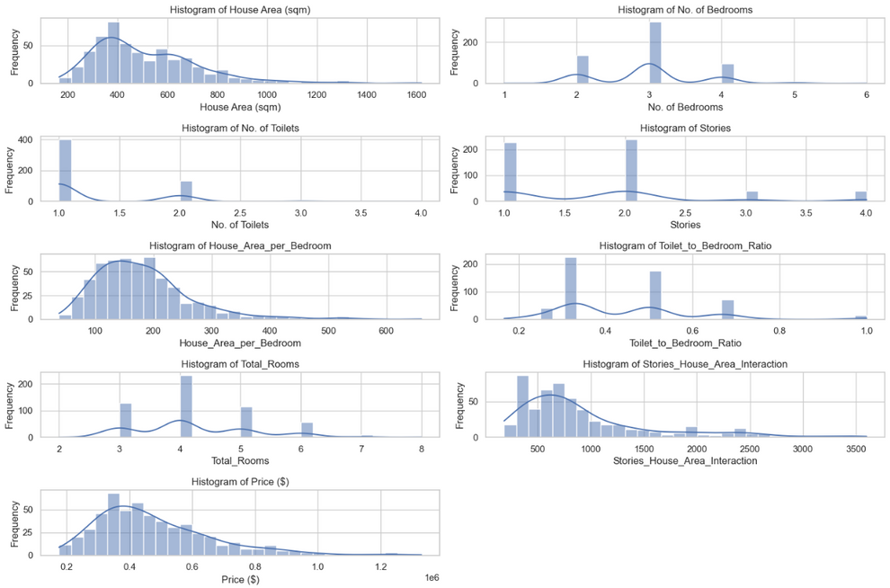
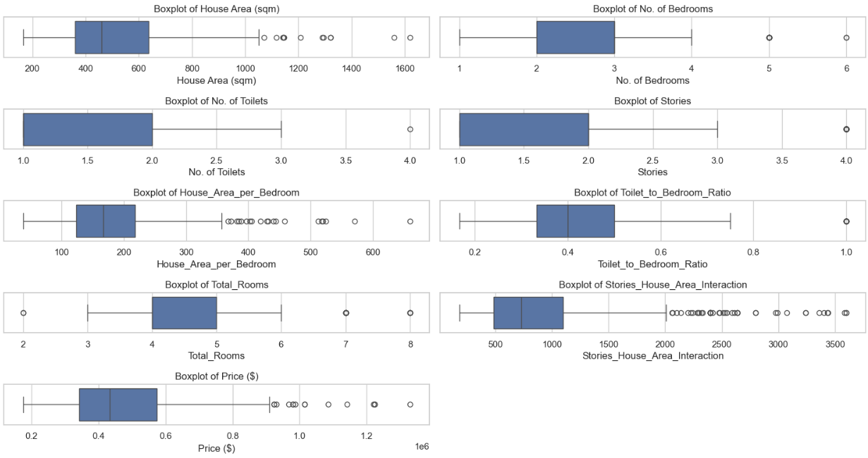
Data Visualisation (Univariate Analysis)
Histogram
Box Plot

Slide 7
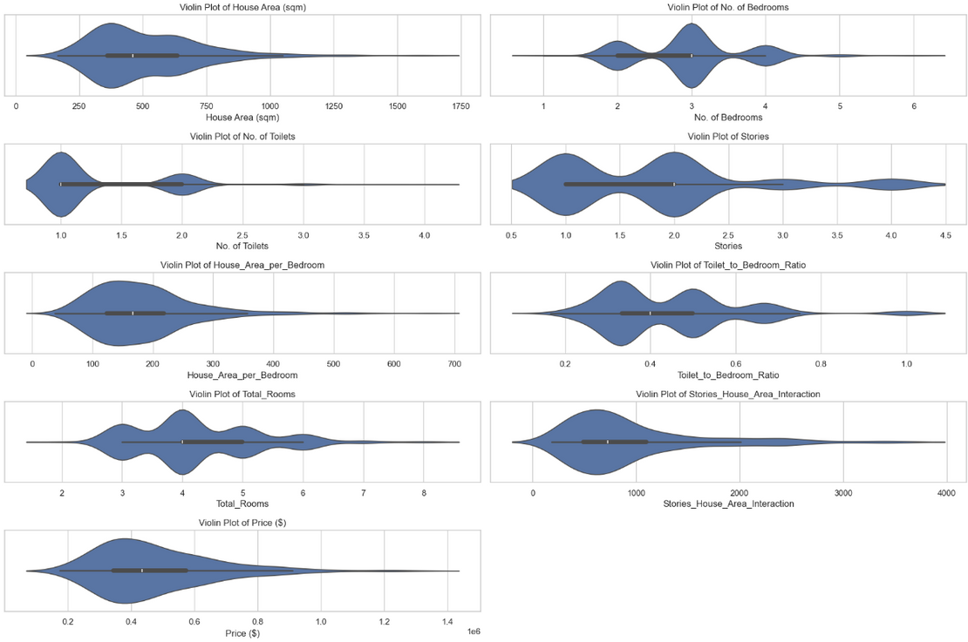
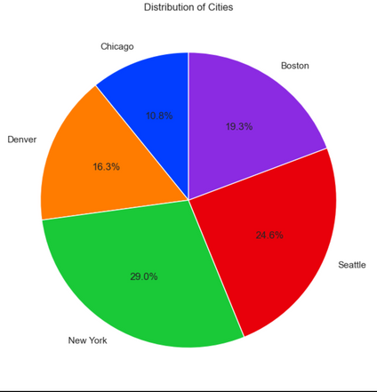
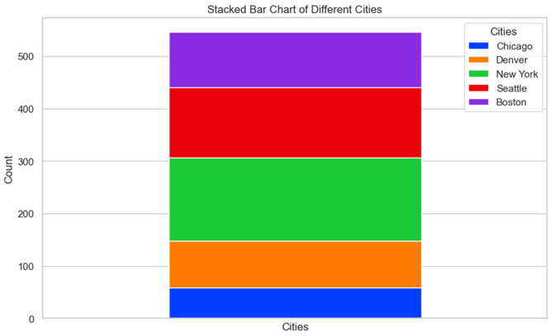
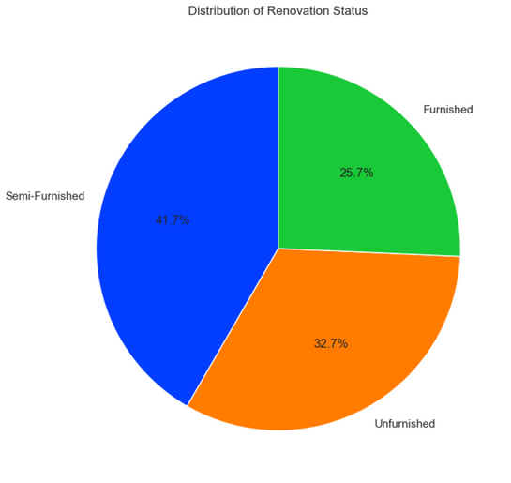
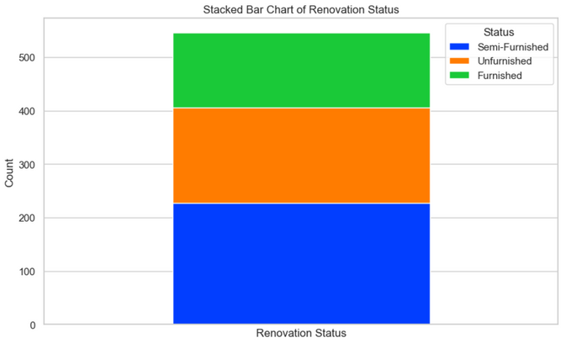
Data Visualisation (Univariate Analysis)
Violin Plot
Cities Pie Chart & Stacked Bar Chart
Renovation Status Pie Chart & Stacked Bar Chart

Slide 8
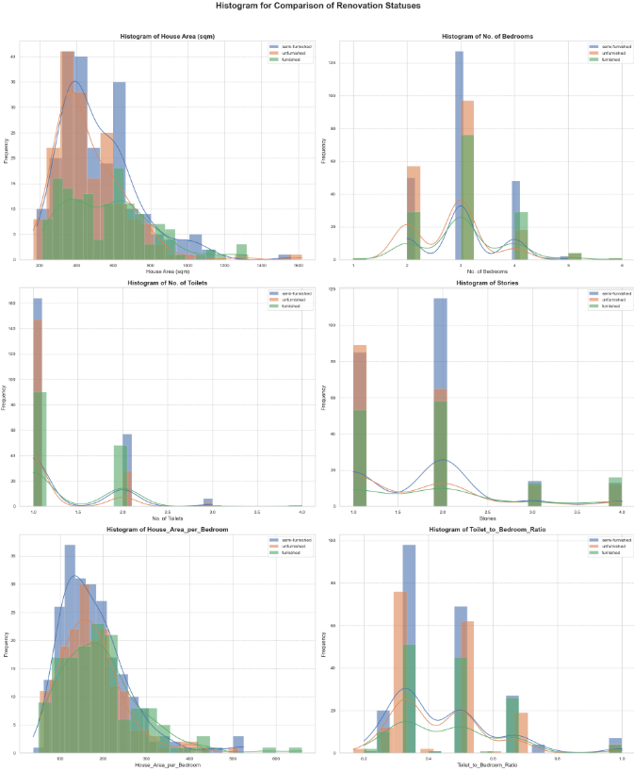
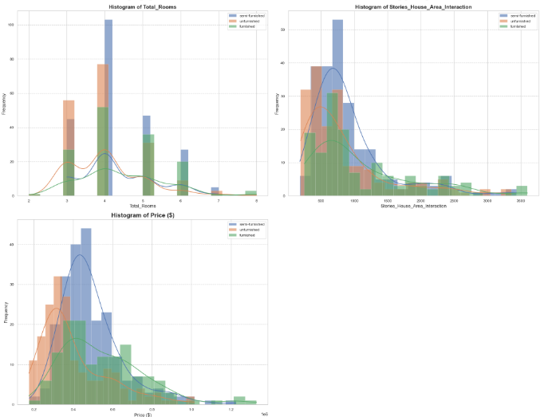
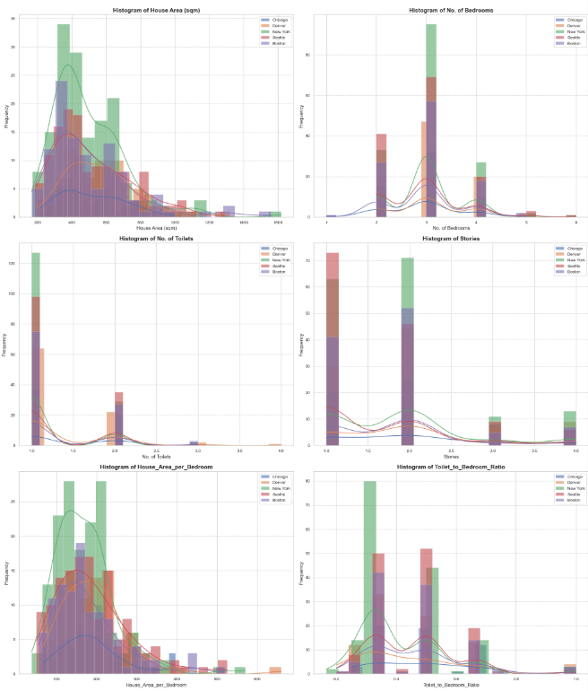
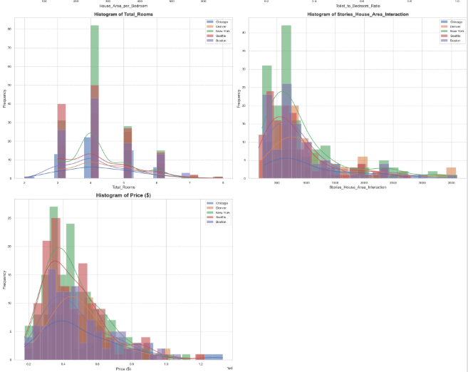
Data Visualisation (Bivariate Analysis)
Histogram (Renovation Status)
Histogram (Cities)

Slide 9
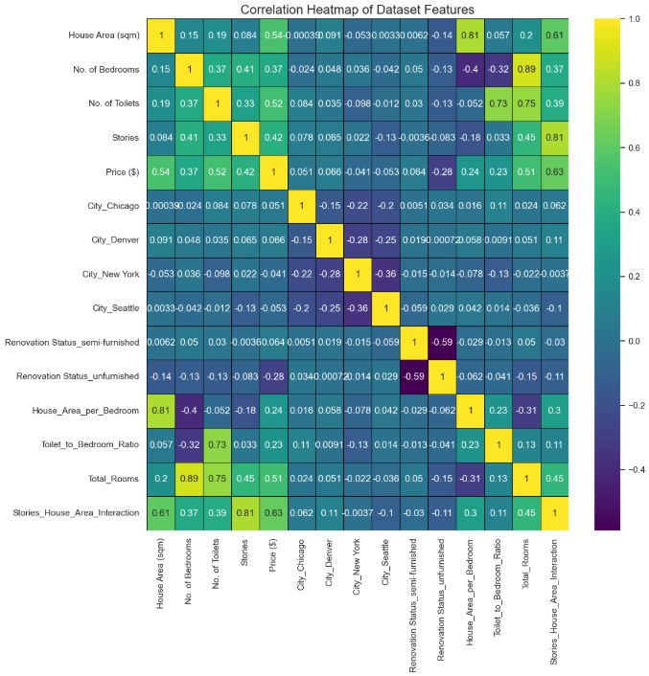
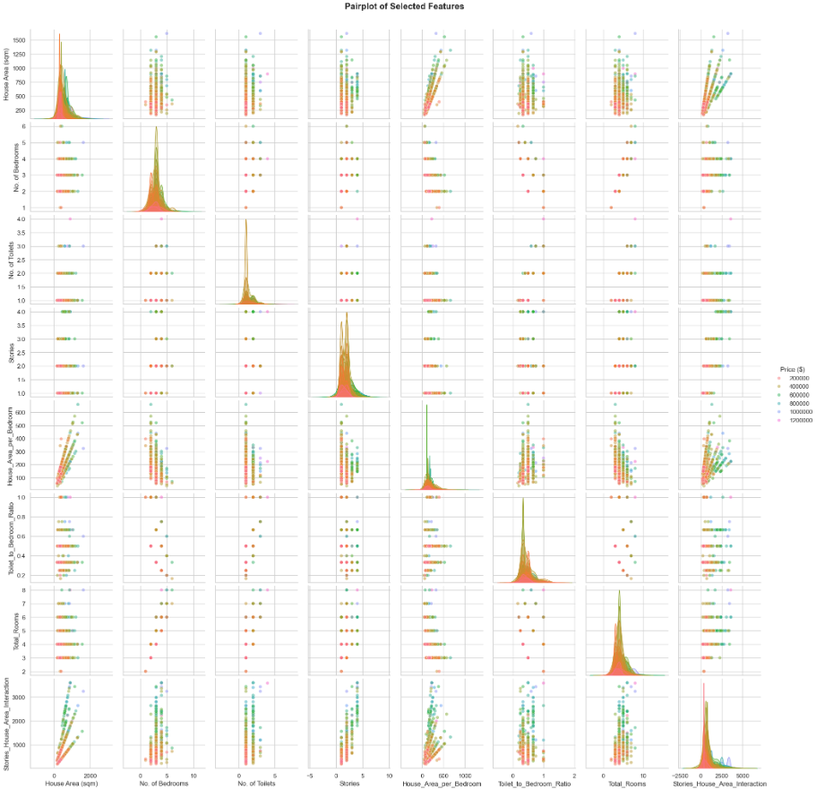
Data Visualisation (Bivariate Analysis)
Pairplot
(With Target Colour Code)
Correlation Heatmap

Slide 10
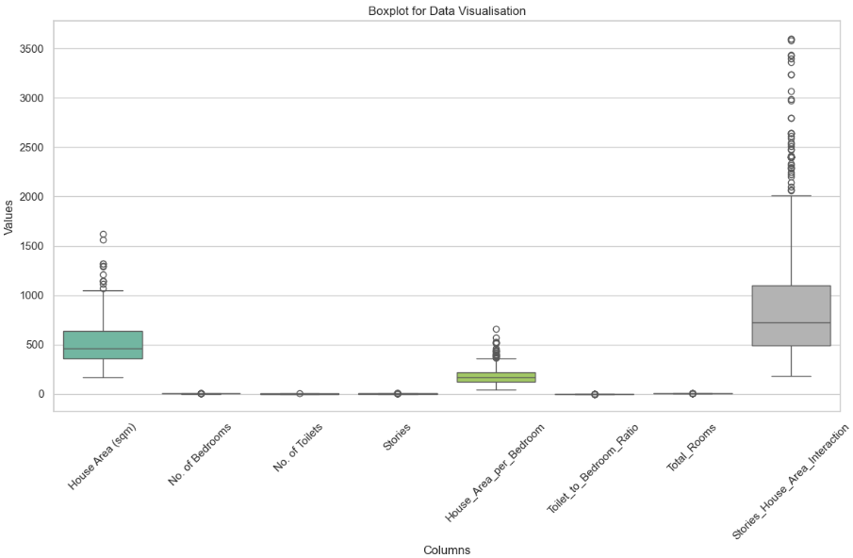
Data Visualisation (Bivariate Analysis)
Box Plot

Slide 11
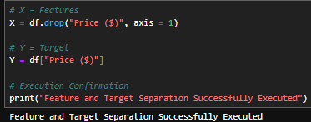
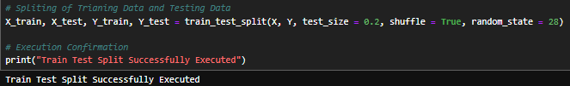
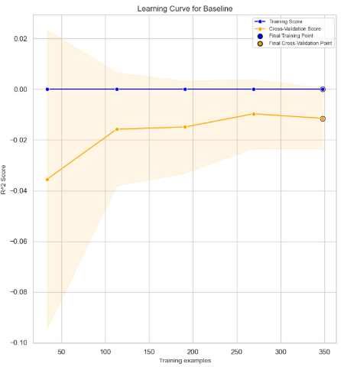
Data Preprocessing and Dummy Baseline
Separation of Feature and Target
Train-Test Split
Dummy Baseline

Slide 12
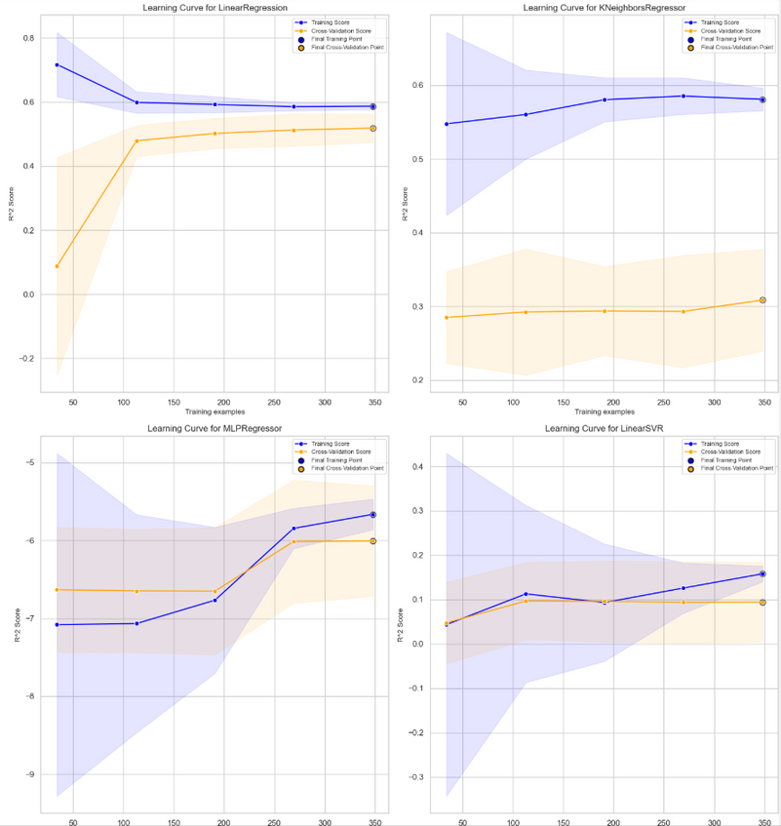
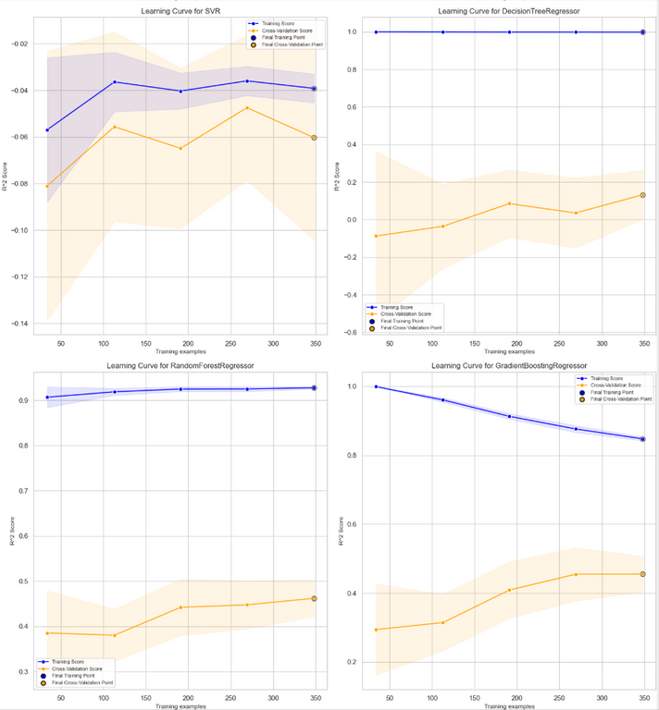
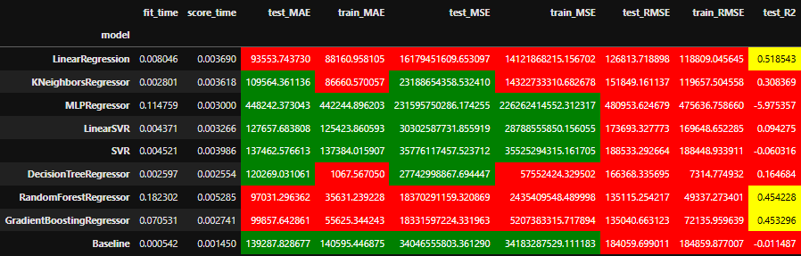
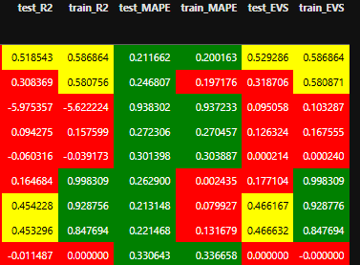
Model Training

Slide 13
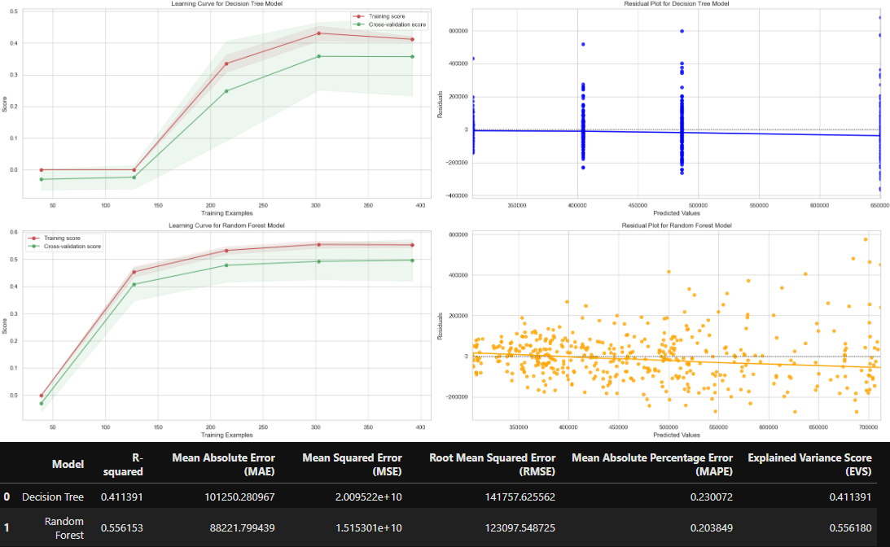
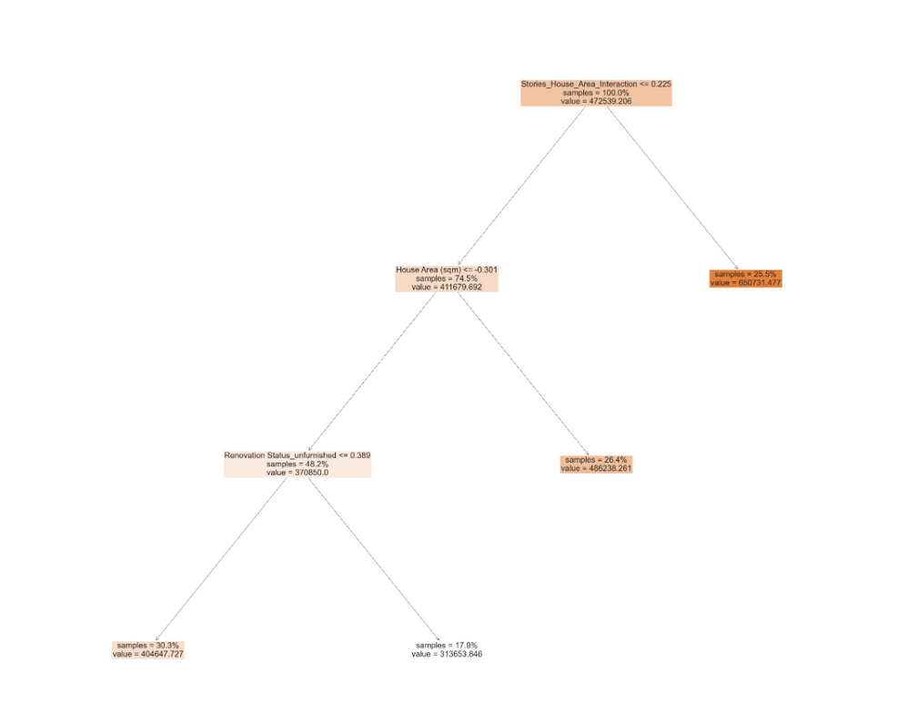
Model Comparison (RFR and DT)

Slide 14
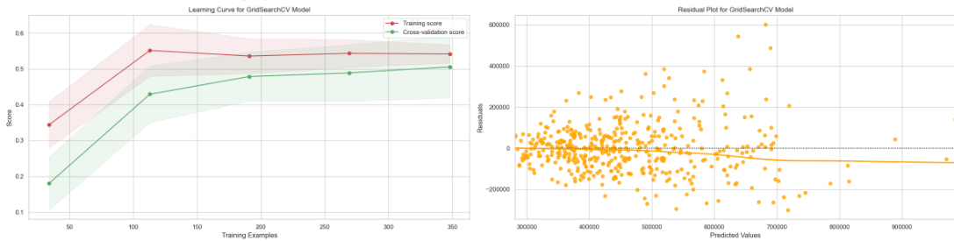
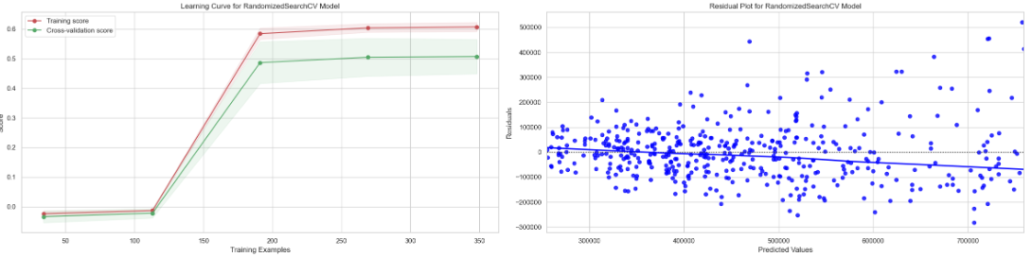
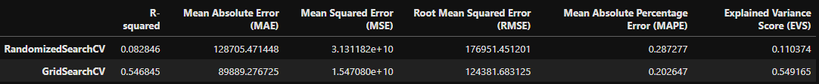
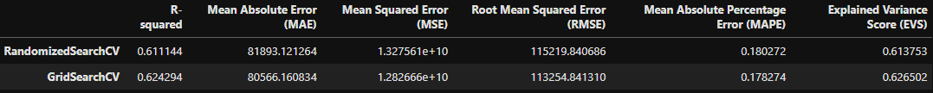
Model Selection and Improvement
Linear Support Vector Regression
Gradient Booster Regressor

Slide 15
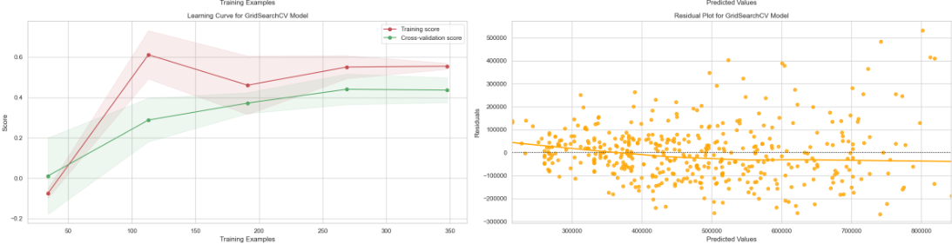
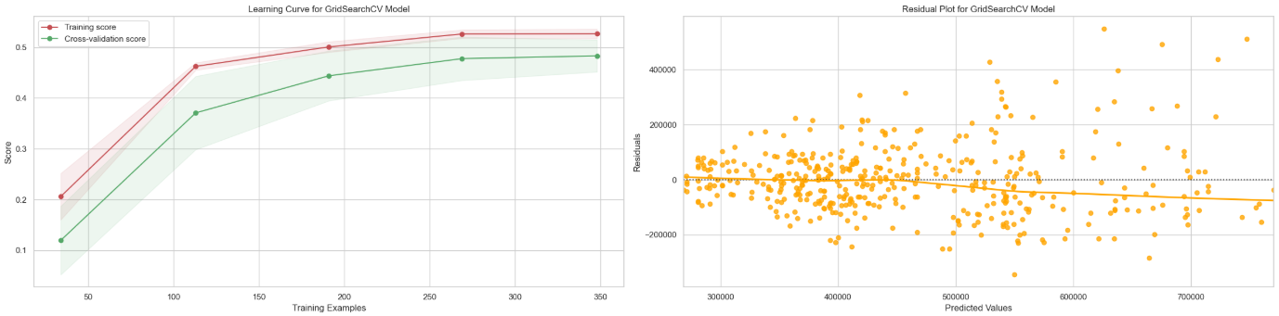
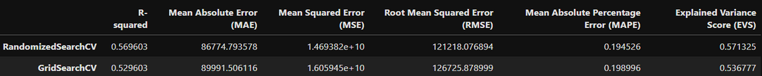
Model Selection and Improvement
K Neighbors Regressor
MLP Regressor

Slide 16
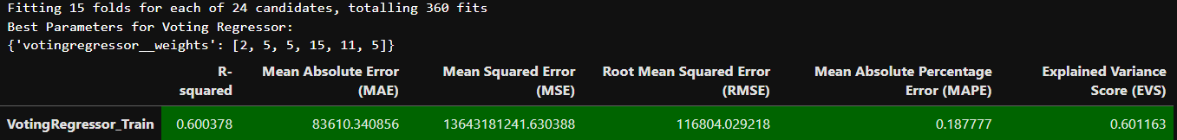
Voting Regressor
Testing on Training Data (Before Hypertuning)
Testing on Training Data (After Hypertuning)
Testing on Training Data (After Hypertuning)

Slide 17
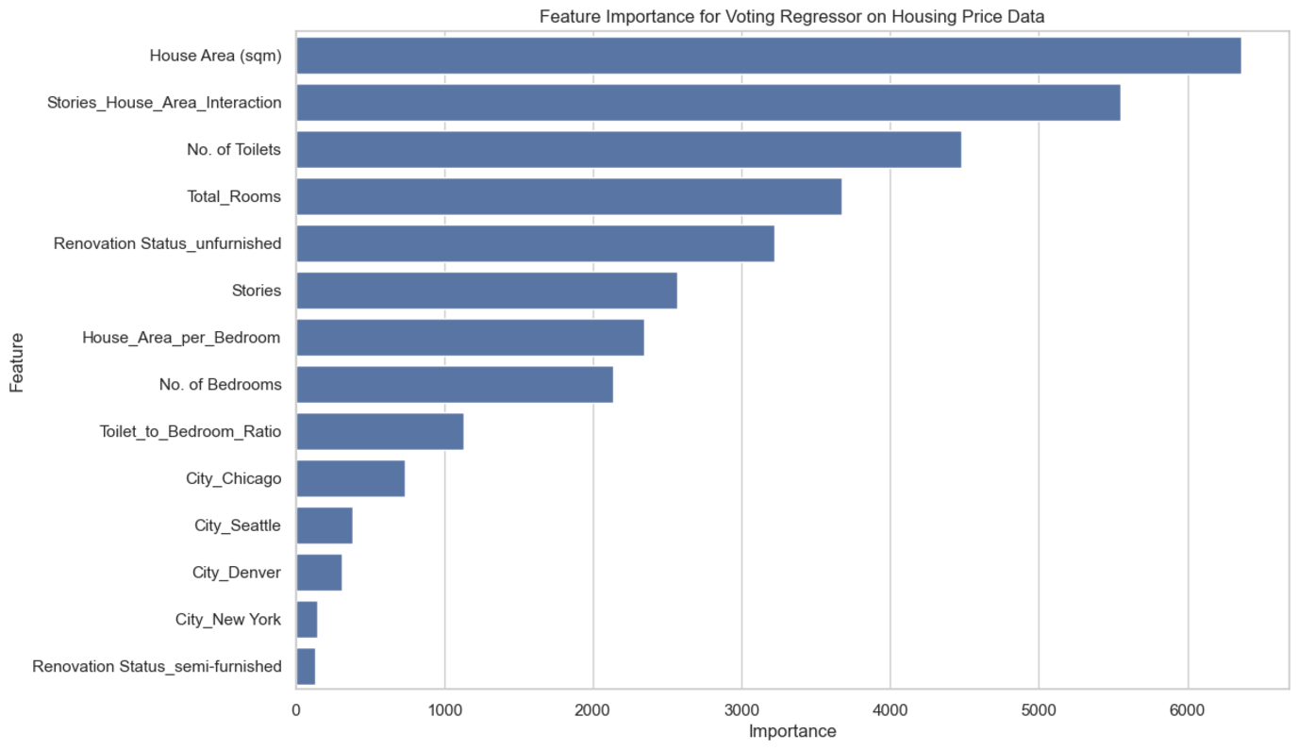
Voting Regressor Feature Importance

Slide 18
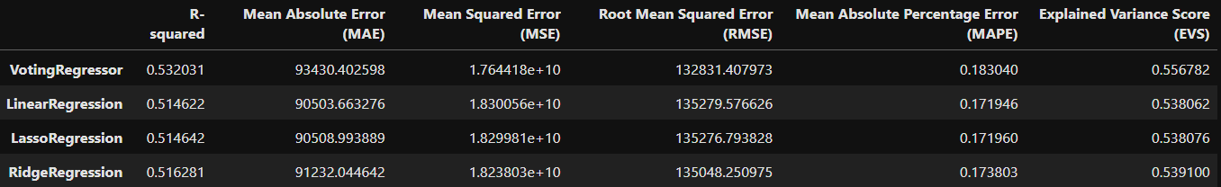
Voting Regressor Comparison
Voting Regressor
vs
Dummy Baseline
Voting Regressor
vs
Dummy Baseline

Slide 19
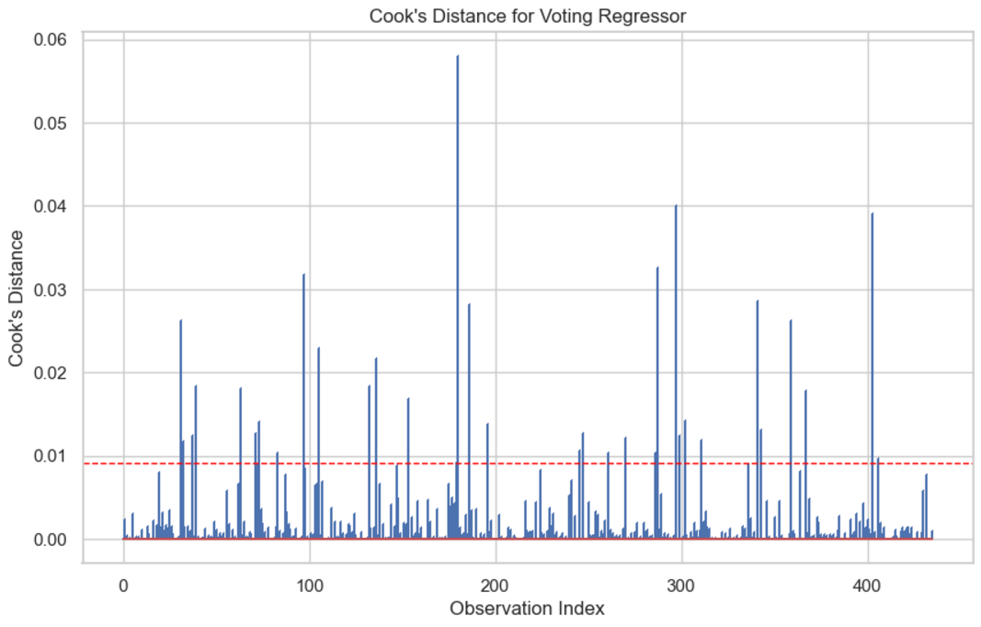
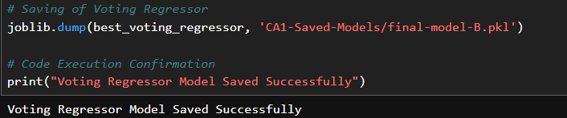
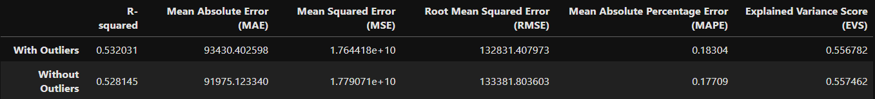
Voting Regressor Influential Points
Cook’s Distance Plot
Saving of Final Model
Scoring Table With Outliers and Without

Slide 20
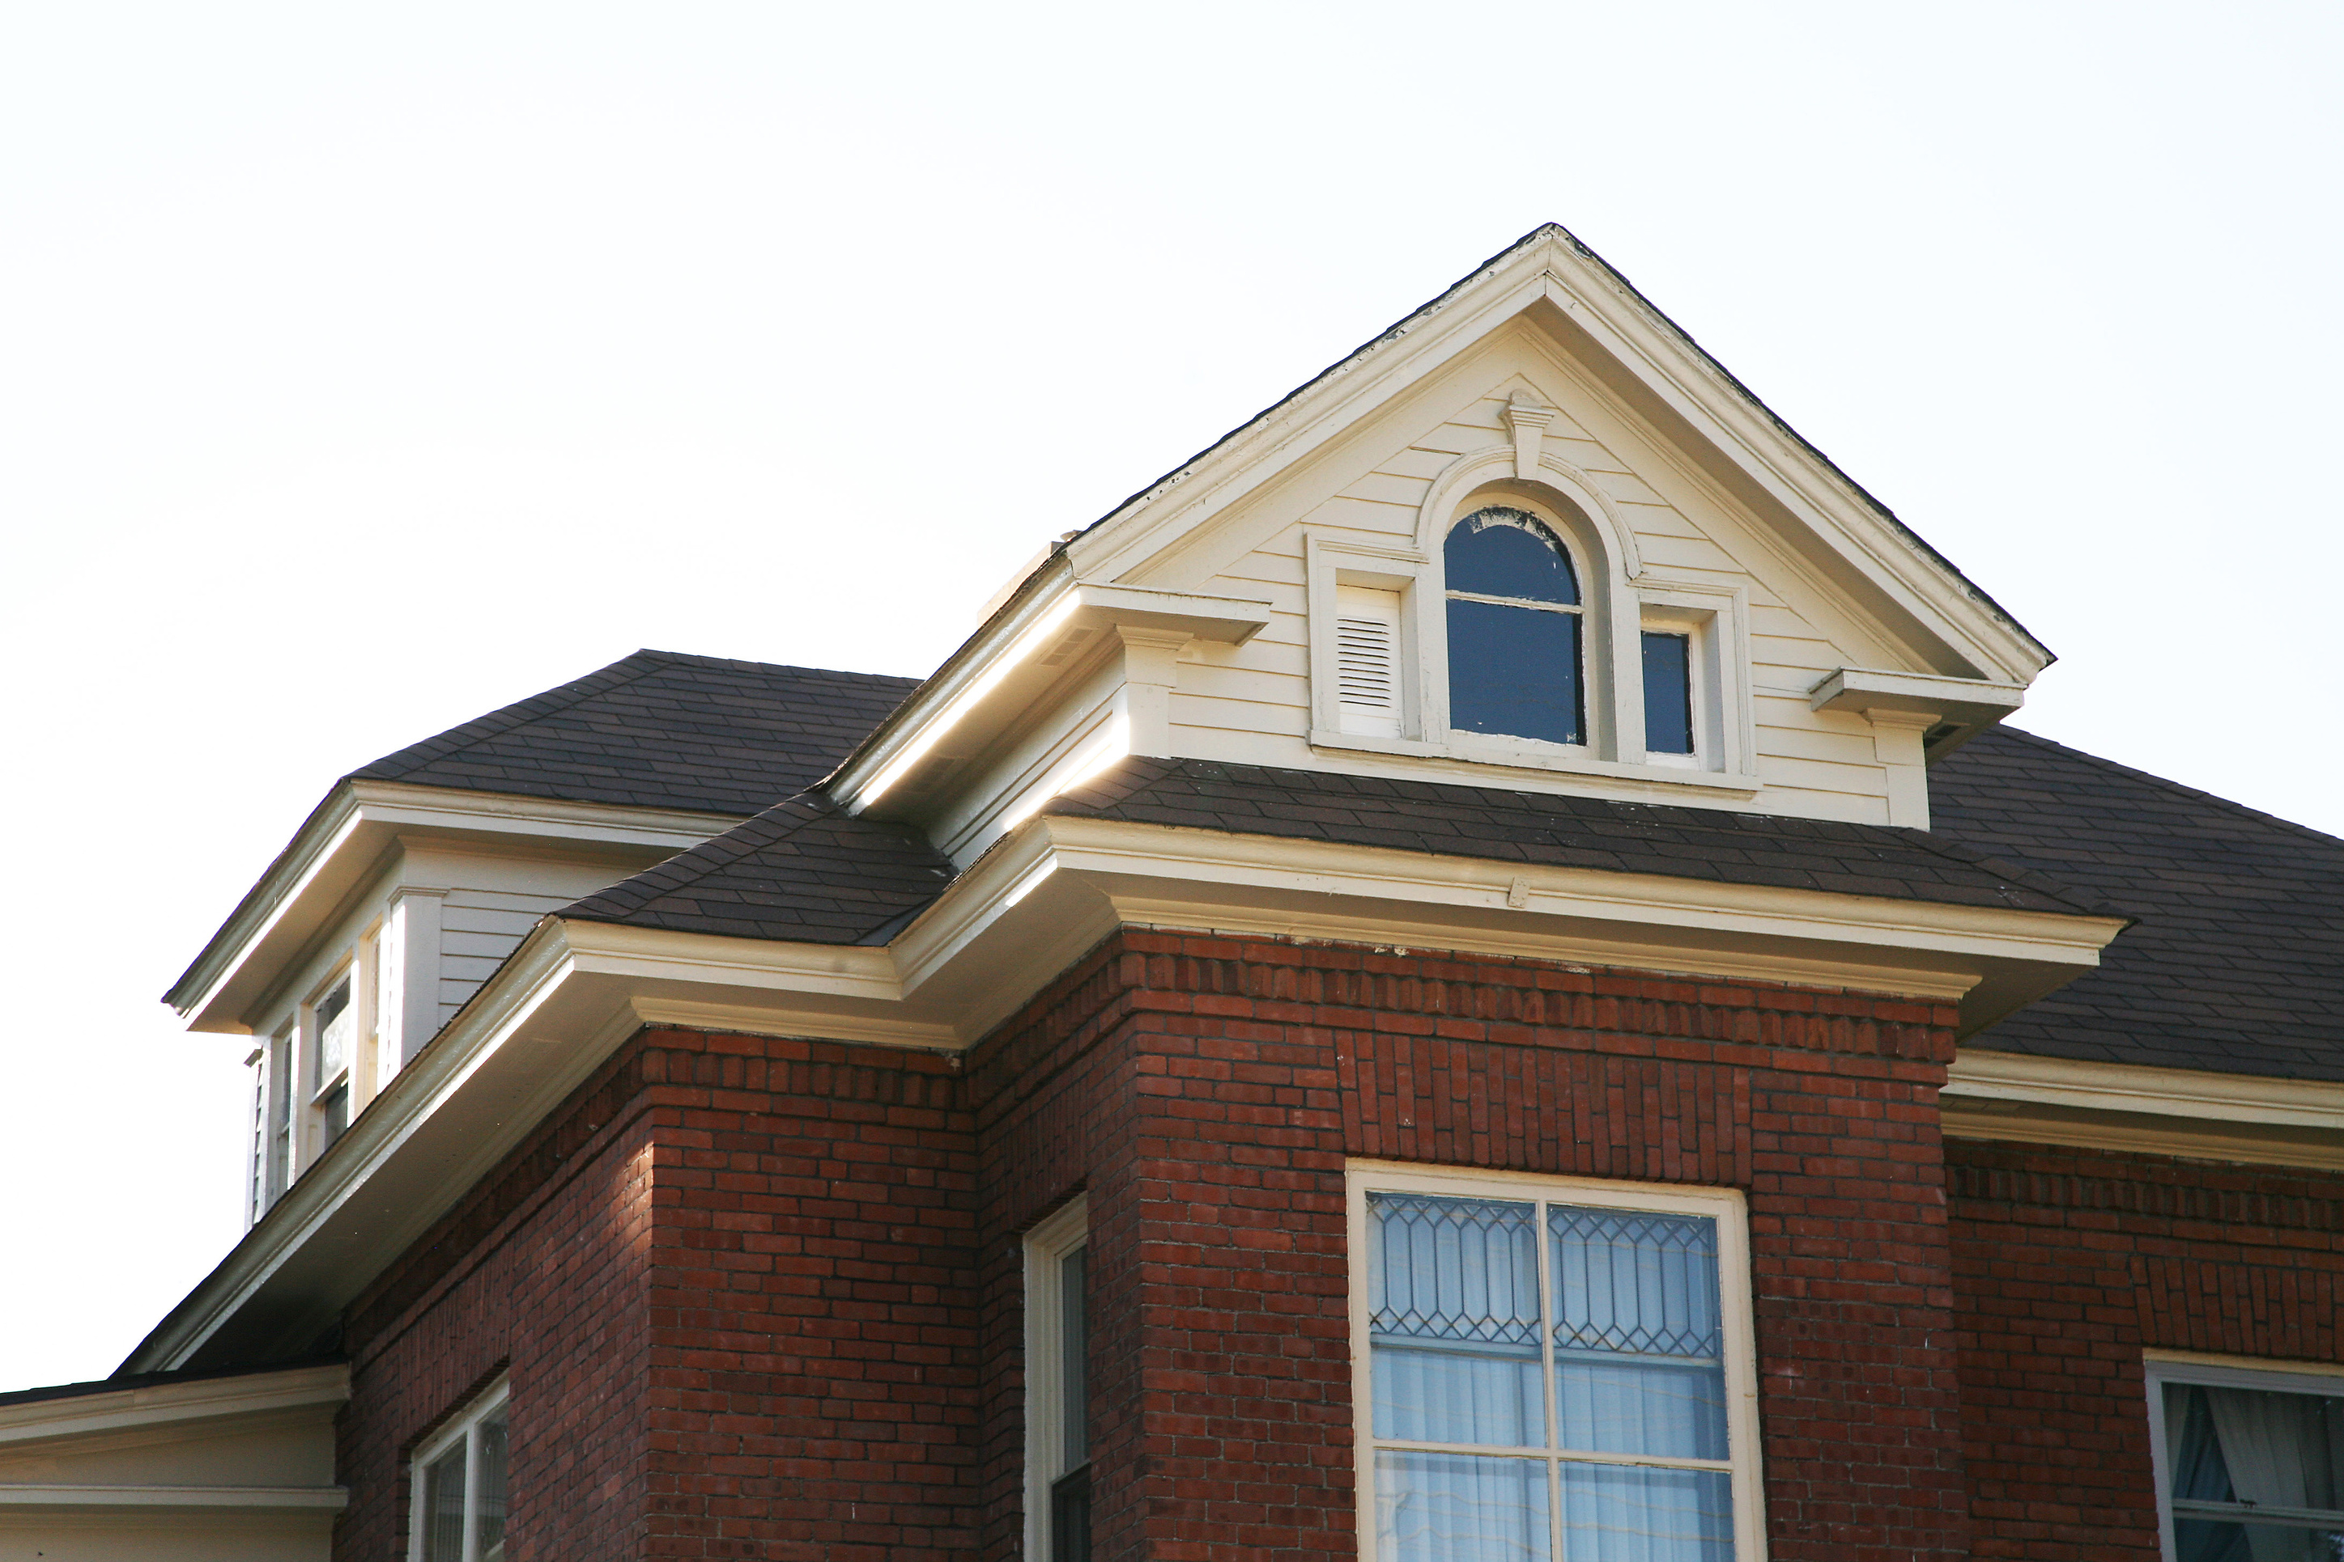
THANK YOU!

